Slide 1
Modeling and Simulation of Magnetic Transmission Lines
Muhammad Shamaas
2018-MS-EE-4

Slide 2
Applications of Magnetic Transmission Lines
Inductors and Magnetic Amplifiers.
Transformers: Power Transformers, Ferro-resonant CVT, Wideband Transformers, Pulse Transformers.
AC / DC Machines.
Computers and RF Electronics: Noise and skin effect suppression using magnetic thin films, ferrite beads and ribbons.
Directional Couplers and Magnetometers.
Induction Heaters and Magneto-resistive Sensors.
Gyromagnetic Devices: Microwave generators and Magnetic Resonance Imaging.

Slide 3
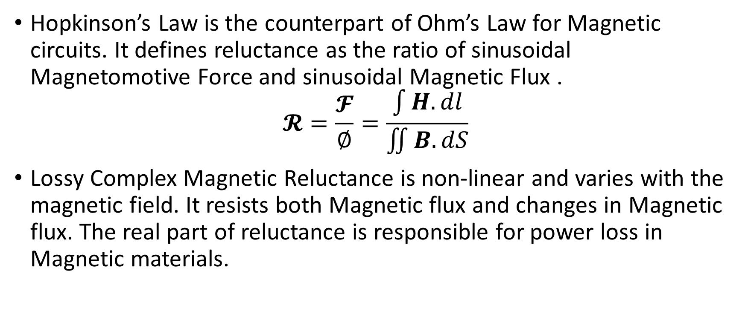
Lossy Complex Magnetic Reluctance Model for Magnetic Circuits
Hopkinson’s Law is the counterpart of Ohm’s Law for Magnetic circuits. It defines reluctance as the ratio of sinusoidal Magnetomotive Force and sinusoidal Magnetic Flux .
$$𝓡=\frac{𝓕}{∅}=\frac{\int{H.dl}}{\iint{B.dS}}$$
Lossy Complex Magnetic Reluctance is non-linear and varies with the magnetic field. It resists both Magnetic flux and changes in Magnetic flux. The real part of reluctance is responsible for power loss in Magnetic materials.

Slide 4
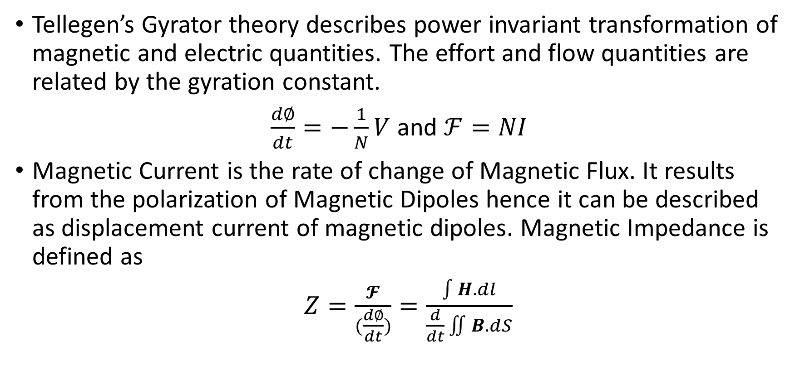
Gyrator-Capacitor Model for Magnetic Circuits
Tellegen’s Gyrator theory describes power invariant transformation of magnetic and electric quantities. The effort and flow quantities are related by the gyration constant.
$\frac{d∅}{dt}=−\frac{1}{N}V$ and $ℱ=NI$
Magnetic Current is the rate of change of Magnetic Flux. It results from the polarization of Magnetic Dipoles hence it can be described as displacement current of magnetic dipoles. Magnetic Impedance is defined as
$Z=\frac{𝓕}{(\frac{d∅}{dt})}=\frac{\int{H.dl}}{\frac{d}{dt}\iint{B.dS}}$

